Slide 1
Who Can Vote?
Constitutional Amendments & More, Part of the Electing our Presidents Series
Kathleen Pate Education Specialist
Clinton Presidential Library

Slide 2
The United States Constitution
Preamble: Mission Statement (Make Students Memorize)
Article I: Legislative Branch = Congress creates the laws.
Article II: Executive Branch = Chief Executive enforces the laws.
Article III: Judicial Branch = Supreme Court (and lower courts) hear cases that challenge laws and judge to determine if the law itself or how it’s enforced is constitutional or unconstitutional.

Slide 3
Constitutional Amendments -
You Do the Math
What is the Bill of Rights? (How many amendments?)
When was it ratified?
How many other amendments to the United States Constitution?
Which two don’t count?
What year is it is now?
After the Bill of Rights, what’s the average number of amendments per year?
That’s the worst word problem ever . . . or is it?!?

Slide 4
Constitutional Amendments -
You Do the Math
What is the Bill of Rights? (How many amendments?) 10
When was it ratified? 1791
How many other amendments to the United States Constitution? 17
Which two don’t count? 18 & 21
What year is it is now? 2021
After the Bill of Rights, what’s the average number of amendments per year?
That’s the worst word problem ever . . . or is it?!?

Slide 5
How Many Amendments Relate
Directly to Voting Rights?
15th - after the 13th and 14th
19th - four more than 15th (we vote for President every four years)
23rd - D.C. (kind of)
24th - no more (poll tax)
26th - 18 years old (?)

Slide 6
How Many Amendments Relate
Directly to the Election Process?
12th - replaces 1st place President, 2nd place Vice-President with run as a pair
17th - Seventeen = Senators, direct election of
20th - changed inauguration date from March 4th to January 20th
22nd - 2 twice = 2 term limit
25th - five = not alive or able

Slide 7
Why don’t people vote?
What people say -
Don’t believe it matters
Don’t care
Lazy
Ignorant
What else?
Other reasons -
Not registered
No access to computer/printer
No ride to polls
Working when polls are open
What else?

Slide 8
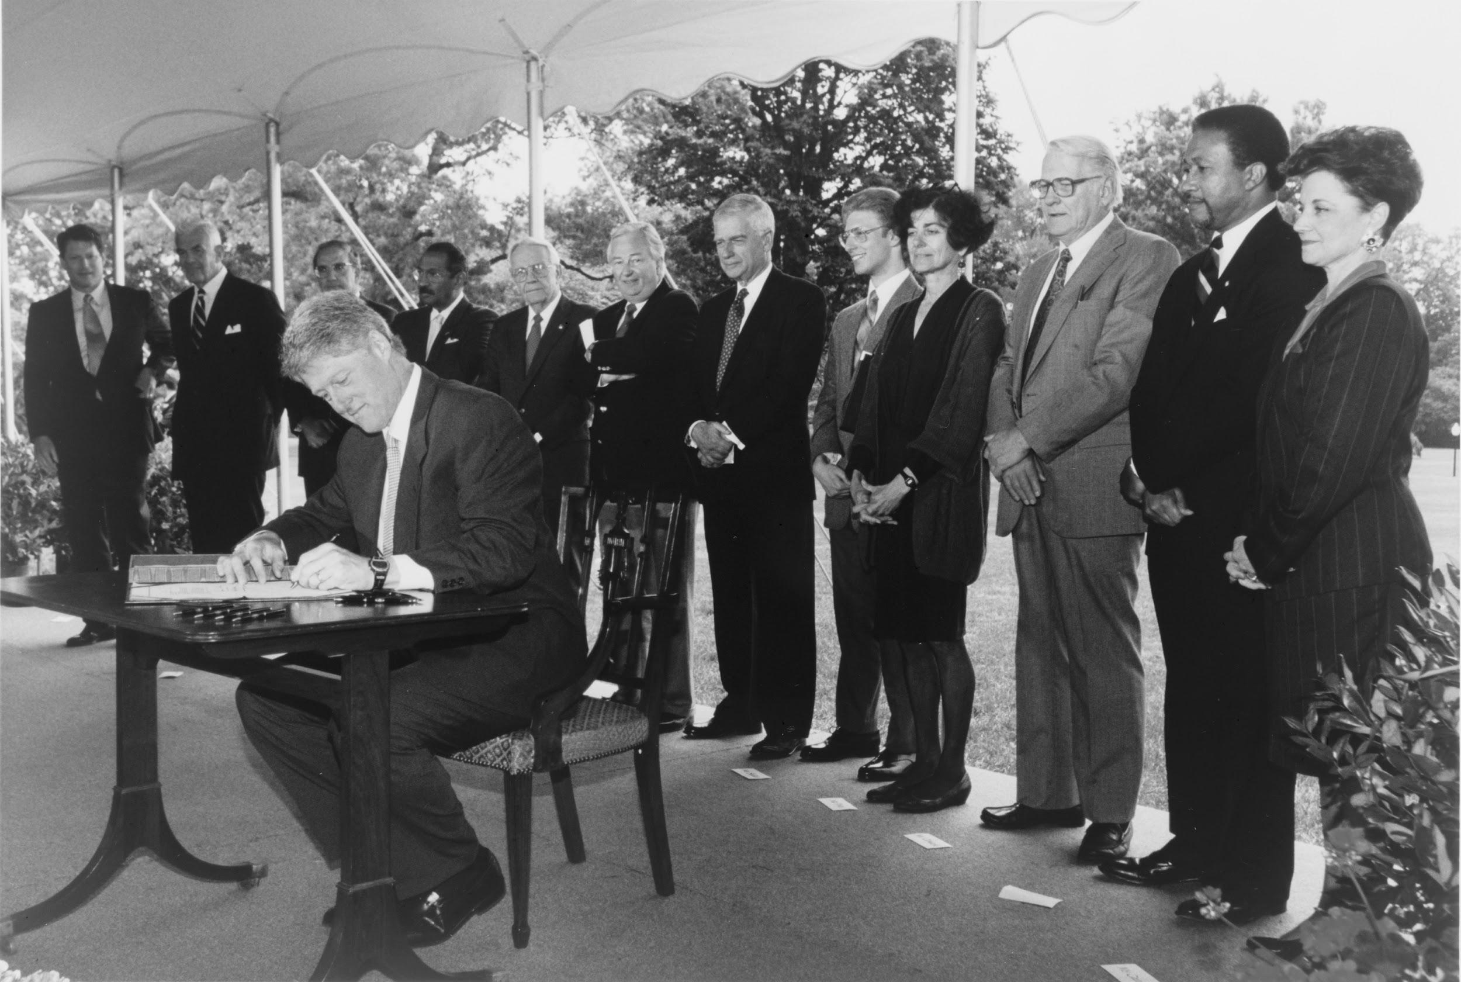
Motor Voter Act 1993
Requires motor vehicle agencies to offer voter registration when you apply for or renew your license, if you are to be 18.
Should the voting age be lowered? How can students have a voice if they can’t vote?

Slide 9
Clinton Presidential Library Resources
www.clintonlibrary.gov
Programs, including Teacher Workshops
Lesson Plans and Activities
The Powers of the Presidency Portal
clinton.presidentiallibraries.us
Search
Browse
Digital Library Exhibits
Topical Research Guides

Slide 10
Let’s Keep In Touch
Facebook WJCLibrary
Instagram wjclibrary42
Twitter @wjclibrary
YouTube ClintonLibrary42
#ArchivesForEducators
#TeacherTuesday
Contact Information
Kathleen Pate
Education Specialist
Clinton Presidential Library
kathleen.pate@nara.gov

