Slide 1
What is the 25th amendment?

Slide 2
Article II, Section 1, Clause 6
In Case of the Removal of the President from Office, or of his Death, Resignation, or Inability to discharge the Powers and Duties of the said Office, the Same shall devolve on the Vice President.

Slide 3
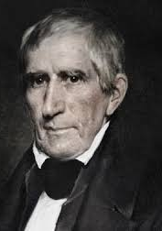
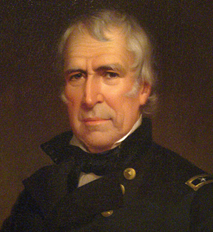
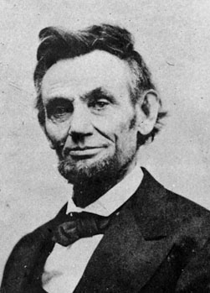
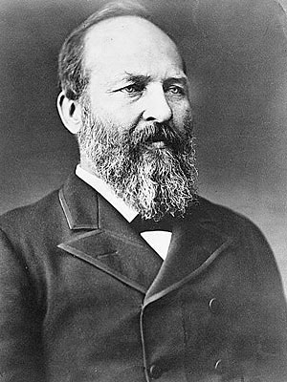
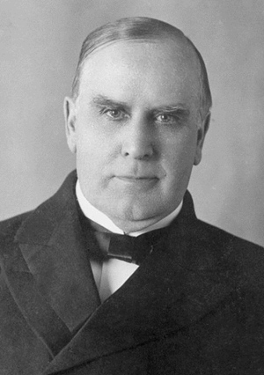
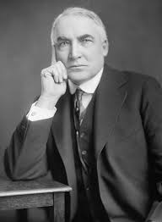
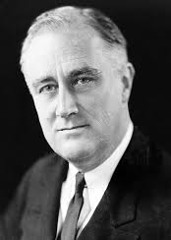
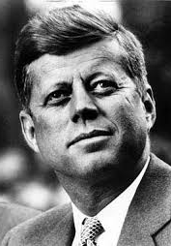
Presidents That Have Died in Office
President William Henry Harrison
President Zachary Taylor
President Abraham Lincoln
President James Garfield
President William McKinley
President Warren Harding
President Franklin Roosevelt
President John F. Kennedy

Slide 4
Accidental Presidents
The United States has had 8 “Accidental Presidents” in it’s 243 year history
Vice Presidents assumed office by the death of the President
John Tyler
Millard Fillmore
Andrew Johnson
Chester Arthur
Theodore Roosevelt
Calvin Coolidge
Harry Truman
Lyndon Johnson

Slide 5
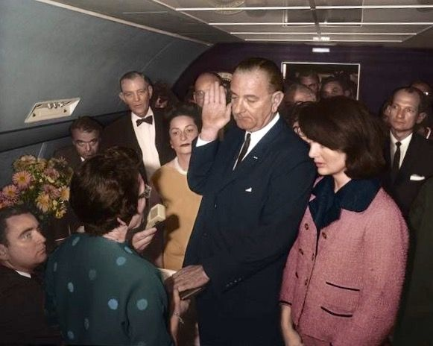
The Last “Accidental” President- November 22, 1963
Vice President Johnson being sworn into office following the assassination of President Kennedy.

Slide 6
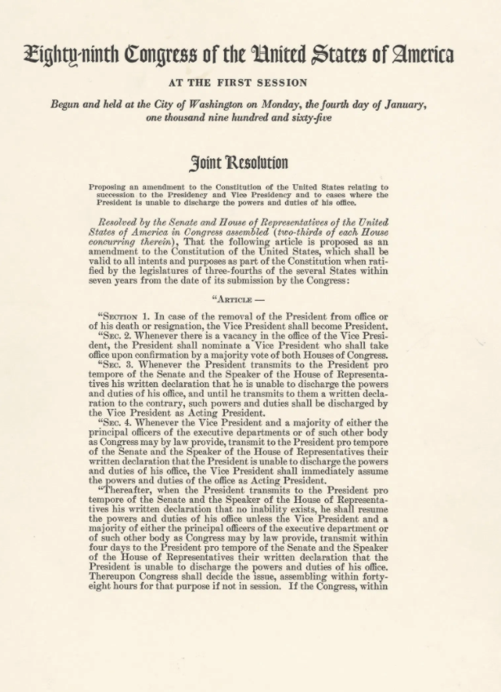
25th Amendment (1967)

Slide 7
Presidential Disability and Succession - 25th Amendment, Sections 1 and 2
Section 1: In case of the removal of the President from office or of his death or resignation, the Vice President shall become President.
Section 2: Whenever there is a vacancy in the office of the Vice President, the President shall nominate a Vice President who shall take office upon confirmation by a majority vote of both Houses of Congress.

Slide 8
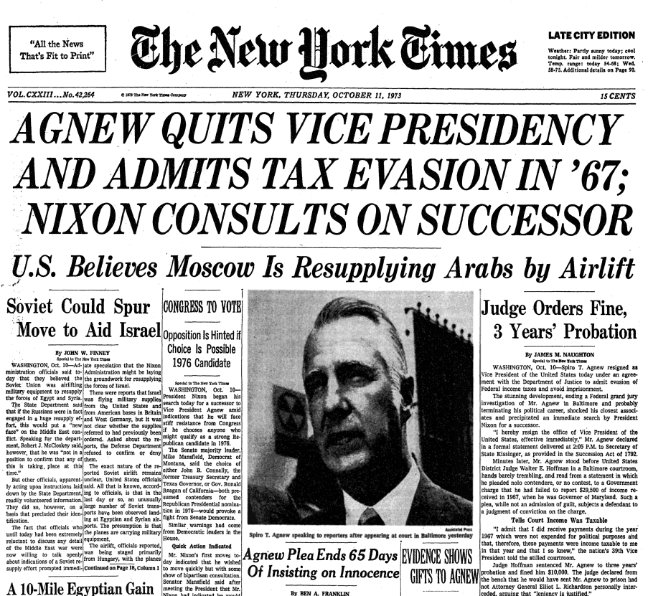
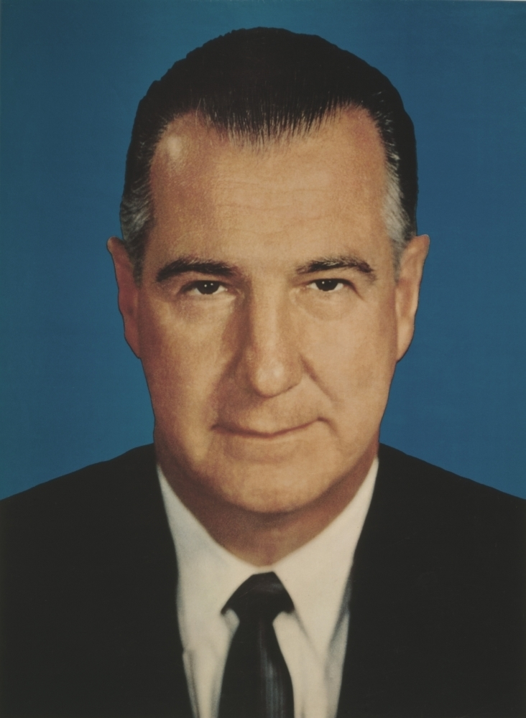
Vice President Agnew Resigns - October 10, 1973

Slide 9
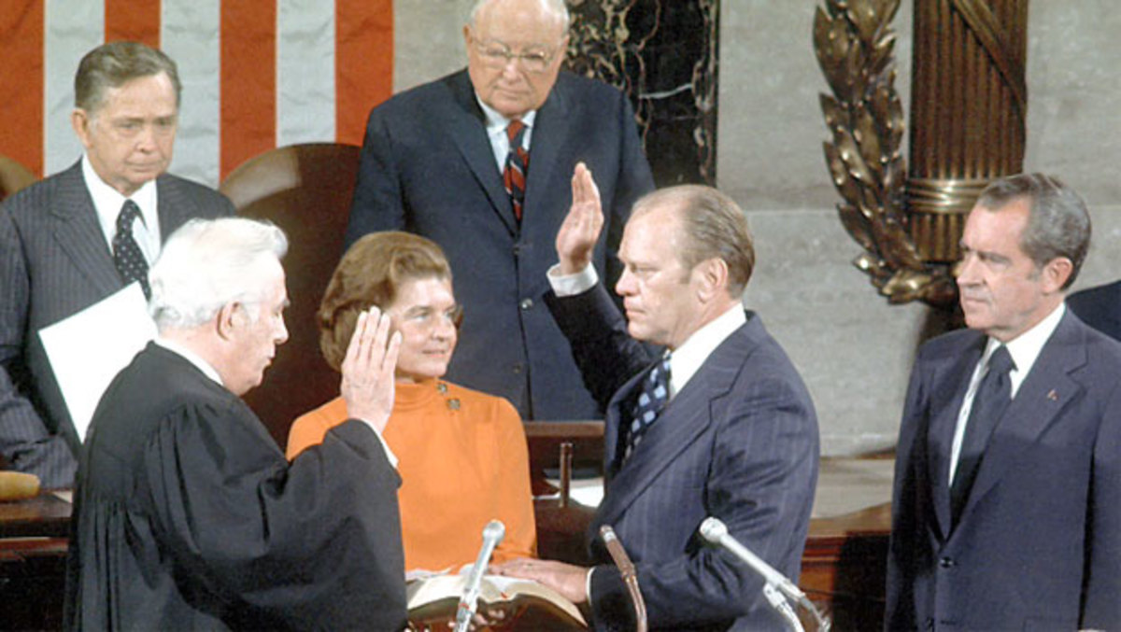
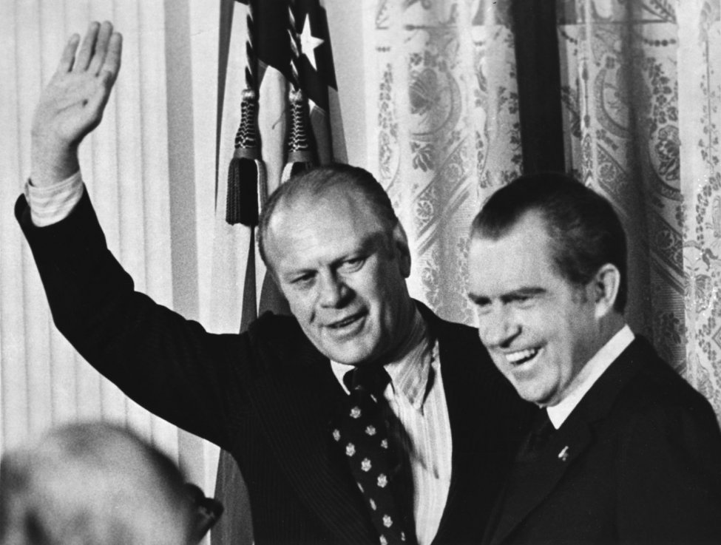
Gerald Ford Appointed Vice President - December 1973

Slide 10
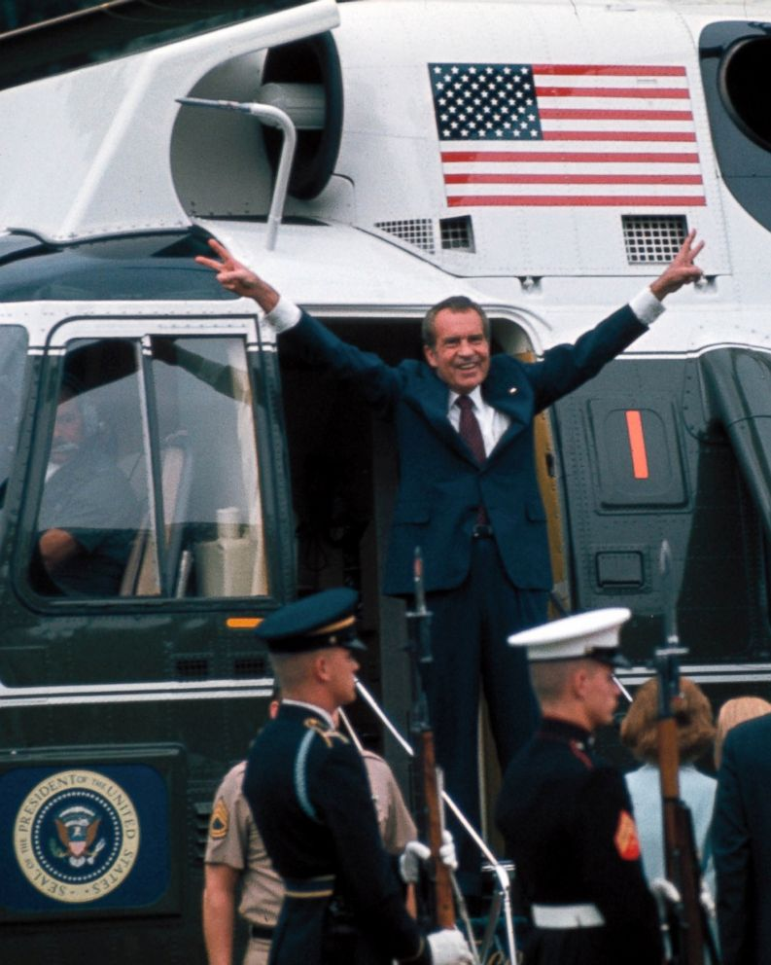
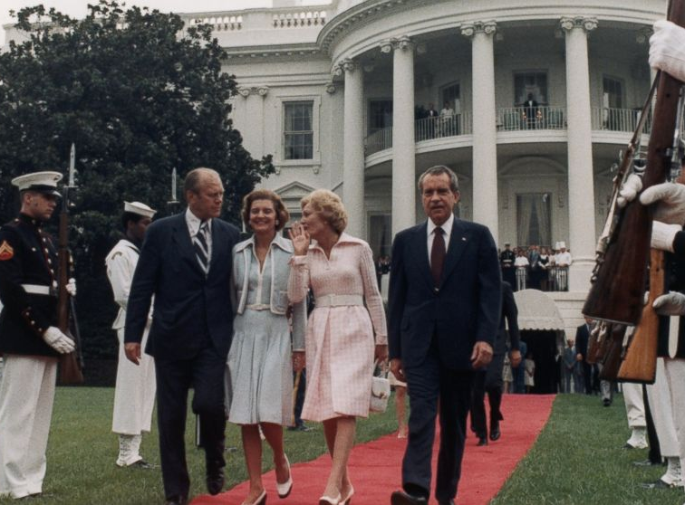
President Nixon Leaves Office - August 9, 1974

Slide 11
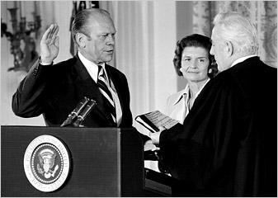
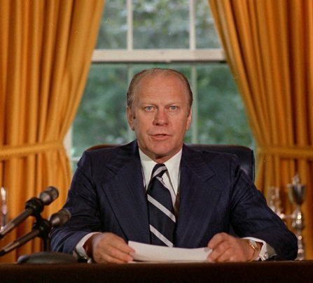
Gerald Ford Becomes President - August 9, 1974

Slide 12
Presidential Disability and Succession - 25th Amendment, Section 3
Whenever the President transmits to the President pro tempore of the Senate and the Speaker of the House of Representatives his written declaration that he is unable to discharge the powers and duties of his office, and until he transmits to them a written declaration to the contrary, such powers and duties shall be discharged by the Vice President as Acting President.

Slide 13
Date | President | Vice-President | From (EST) | To (EST) | Reason for Presidential Disability
21-Jul-07 | George W. Bush | Richard B. Cheney | 7:16AM | 9:21AM | Colonoscopy
Discharge Letter: |  | Letter to Congressional Leaders on the Temporary Transfer of the Powers and Duties of President of the United States
Resumption Letter: |  | Letter to Congressional Leaders on Resuming the Powers and Duties of President of the United States
29-Jun-02 | George W. Bush | Richard B. Cheney | 7:09AM | 9:24AM | Colonoscopy
Discharge Letter: |  | Letter to Congressional Leaders on the Temporary Transfer of the Powers and Duties of President of the United States
Resumption Letter: |  | Letter to Congressional Leaders on Resuming the Powers and Duties of President of the United States
13-Jul-85 | Ronald Reagan | George Bush | 11:28AM | 7:22PM | Colon cancer surgery
Discharge Letter: |  | Letter to the President Pro Tempore of the Senate and the Speaker of the House on the Discharge of the President's Powers and Duties During His Surgery
Resumption Letter: |  | Letter to the President Pro Tempore of the Senate and the Speaker of the House on the President's Resumption of His Powers and Duties Following Surgery

Slide 14
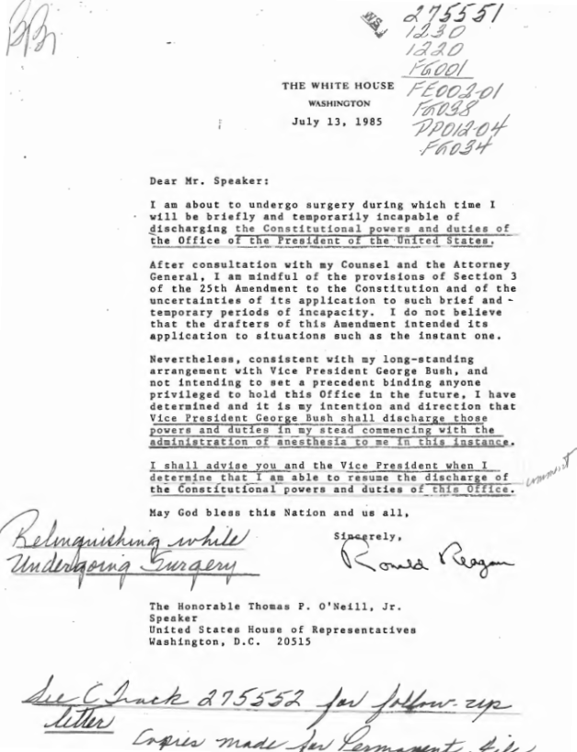

Slide 15
Presidential Disability and Succession - 25th Amendment, Section 4
Whenever the Vice President and a majority of either the principal officers of the executive departments or of such other body as Congress may by law provide, transmit to the President pro tempore of the Senate and the Speaker of the House of Representatives their written declaration that the President is unable to discharge the powers and duties of his office, the Vice President shall immediately assume the powers and duties of the office as Acting President.

Slide 16
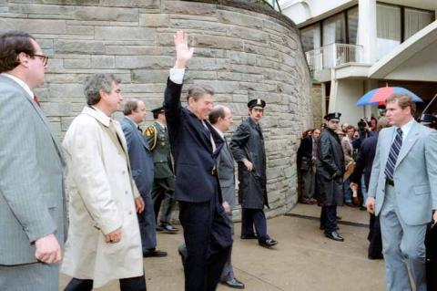
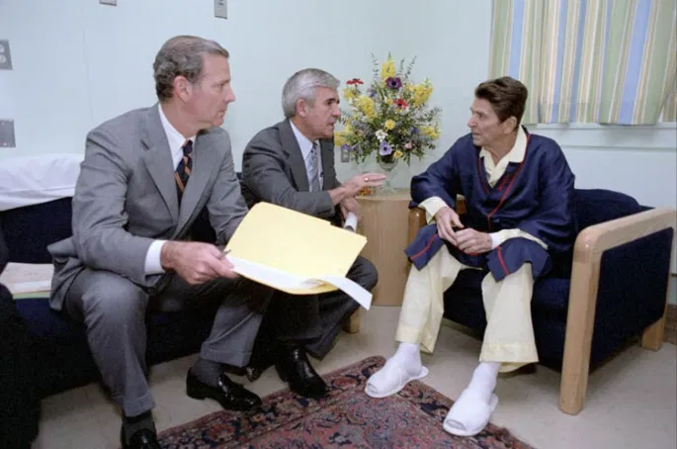
President Reagan and the 25th Amendment

Slide 17
For More Information:
reaganlibrary.gov
situationroom.archives.gov

